Slide 1

disQover
The AI tool to find, analyze and evaluate startups
TEAM:
Cosima Faller
Florian Faller Alexander Haller Demyan Kurbatov Jijo Valiyaveettil

Slide 2
Notes:
VC investing is (not) Gambling
Imagine betting in a horse race – you pick the horse which looked healthiest, strongest, fastest. But a different horse makes the race. You did not bet on this one though, because you did not know that it had a better rider and because you put too much weight in your decision on the breed instead of its former training.

Slide 4

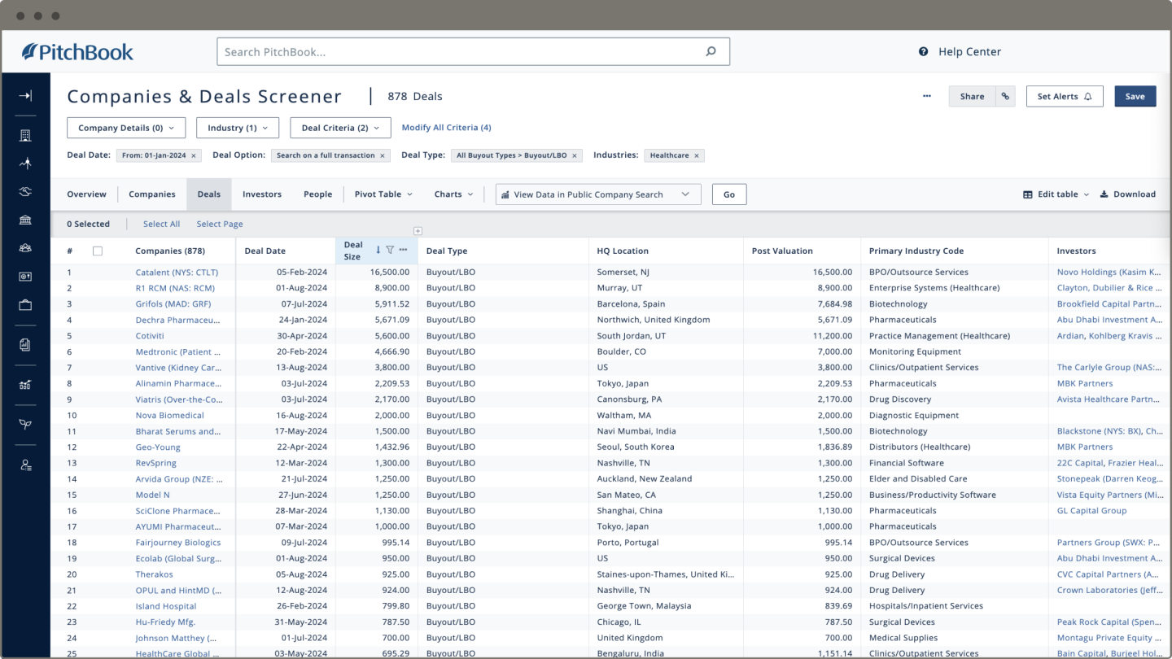




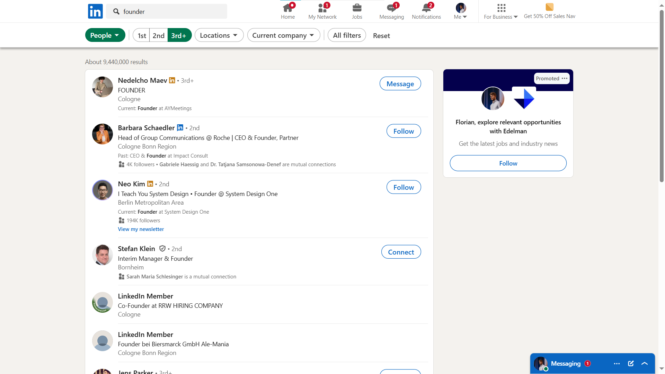


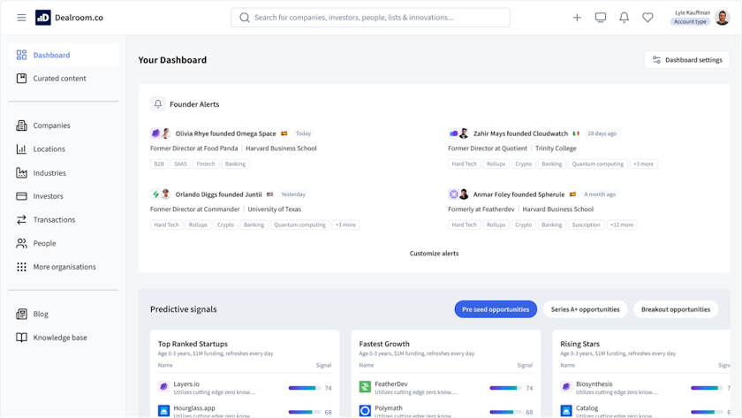
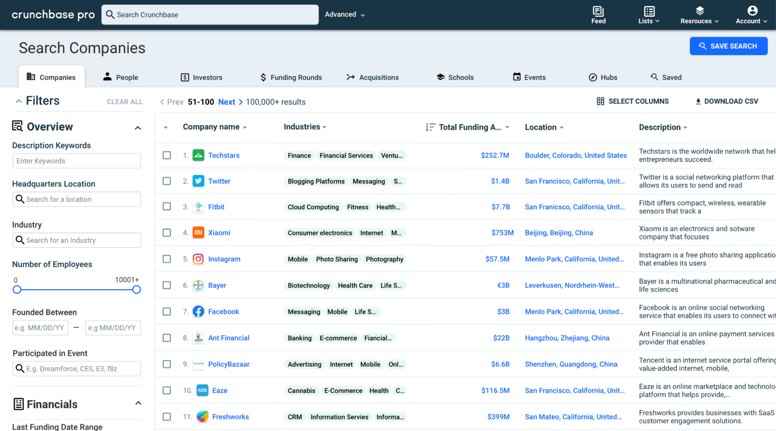



VC Investing feels too much like gambling and too little like informed Deciding
PRoblem
Investing relies too much on:
Incomplete data
Missing benchmarks
Imperfect criteria weighting
Notes:
This brings us to VC investing. We are betting, not on horses, on startups. VCs make good, sometimes bad, sometimes great deals, but how to pick the best ones? You dont have all relevant data. Even if you have data, you dont know if a CLTV/CAC ratio of 2 is good or bad. And even if you get a feeling for this, you might still put the wrong weights on your decision criteria.

Slide 5







Solution
We help investors make better Decisions
Startup Data Input
AI Agents & Crawlers
Overview & Recommendations
Pitch Deck
LinkedIn
Target Data Overview
Financials
News
Data Explanations
Individual Observations
Financial Data
Investment Recommendation
Web Search Data

Slide 6
Solution
We Analyze investment potential
TARGET ANALYSIS
INDUSTRY ANALYSIS
Startup Data
Pitch Deck
Financials
Individual data
Crawled Data
Social Media
GitHub
Databases
Crawled Public Data
Crunchbase dataset analysis
Expert Benchmarks
VC investors chosen KPIs
TARGET EVALUATION
Overview of Target KPIs vs. Industry Benchmarks
LLM Background Explanations
Investment Recommendation

Slide 7
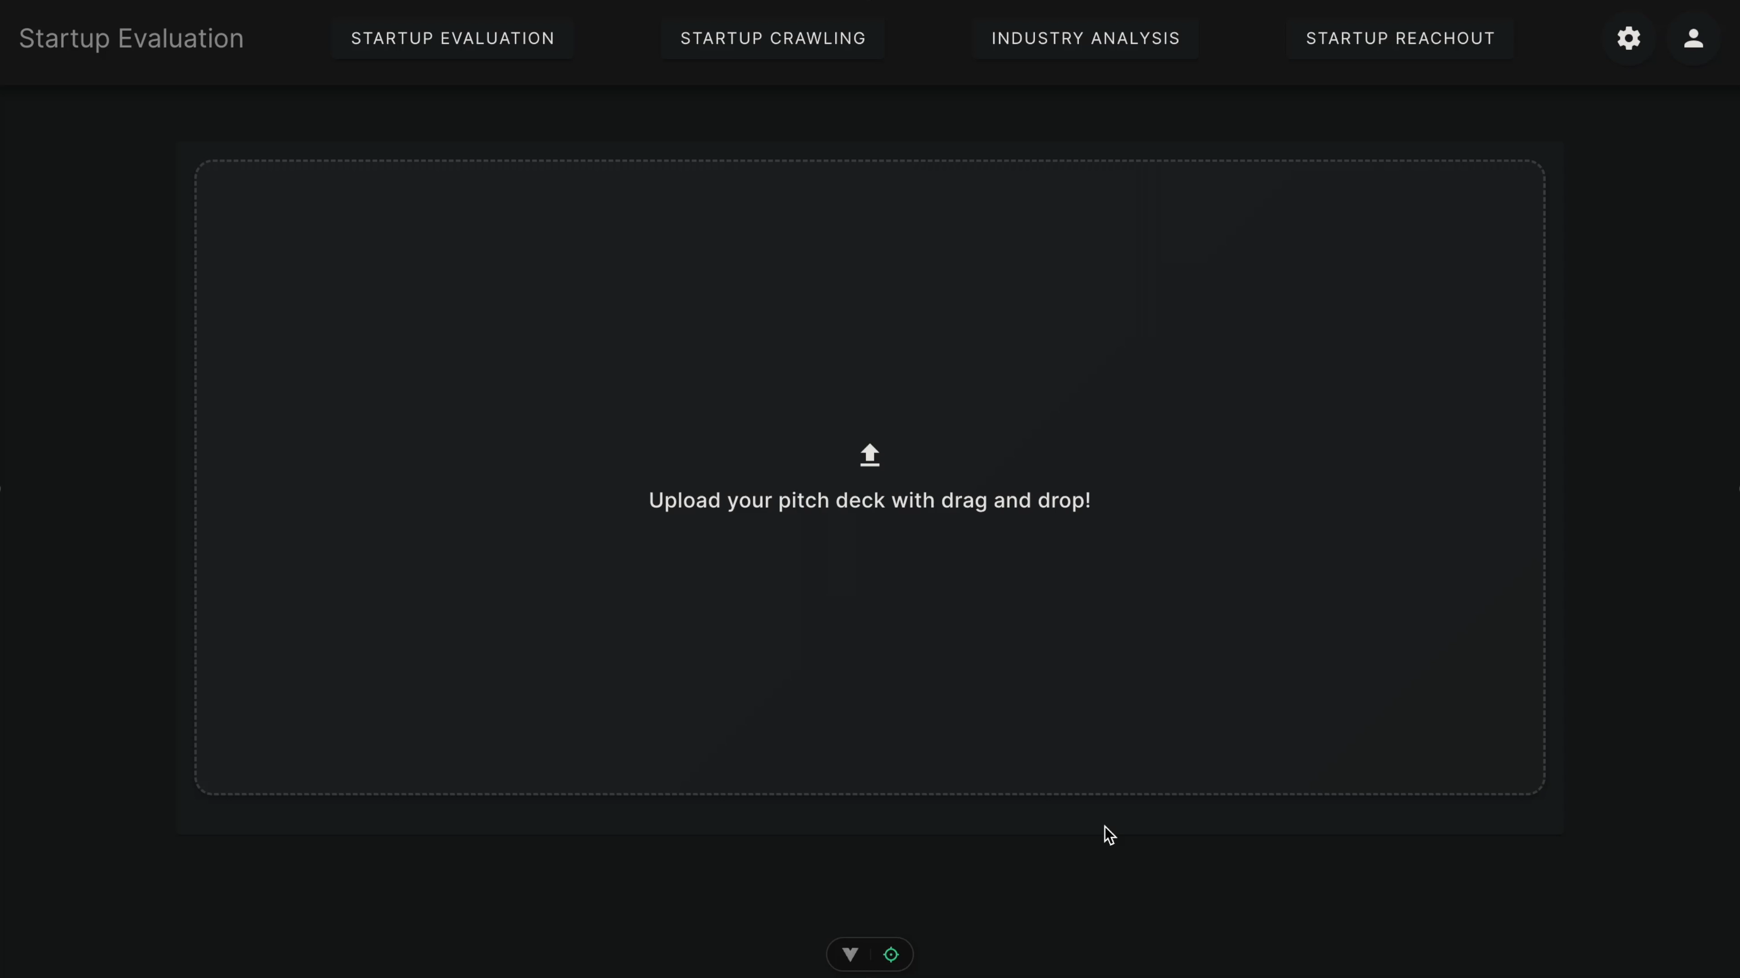
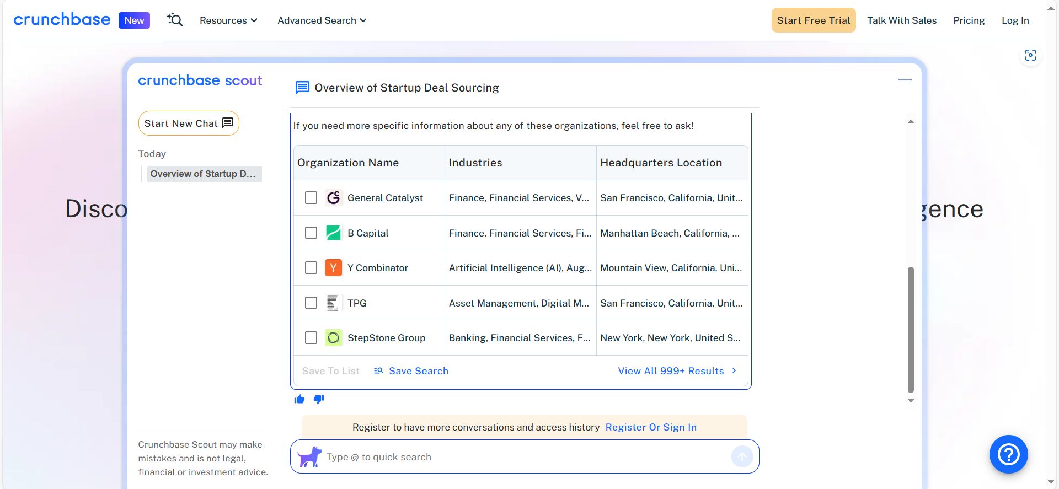
SOLUTION

Slide 8












Lack of data and ai driven Evaluation tools
Competition
PAYABLE
Pitch Feedback for Startups
(mostly LLM based)
Startup Overview
for VCs
(data based)
Startup Overview and Evaluation for VCs
(data and LLM based)
DISQOVER
Best of both worlds
USP: Based on actual data, not just LLMs
Expensive

Slide 9
The market is huge and allows to scale
Market
TAM $801.8m
SAM $120.3m
Full VC Suite incl. Evaluation, Outreach, Market Reports, Tax…
Worldwide Adoption
SOM $18.0m
Evaluation Tool
Worldwide Adoption
Evaluation Tool
Adoption in Germany
Notes:
Venture Capital Fonds: ~10.000 —> Annual willingness to pay: $2.000–$10.000
Business Angels: ~100.000 —> $300–$1.000
Accelerator/Inkubator: ~3.000 —> $2.000–$5.000
Corporate VS: ~1.500 —> $10.000–$50.000
Public: ~500–1.000 --> $5.000–$25.000

Slide 10
Business model
We have a scalable, intuitive saas model
Free trial
Basic
Premium
one week
0€ per user
3 evaluations
Basic Scoring
monthly
69€ per user
10 evaluations/month
Complete scoring
Industry deep dives
monthly
2690€ per company
Unlimited evaluations
Industry deep dives
Dealflow-Integration (CRM)
Investment Recommendations

Slide 11
We can scale horizontally and vertically
Market
Market Insights
Startup Outreach
AgTech
ClimateTech
Startup Evaluation for SaaS Tools
HealthTech
FinTech
Construction
Tech
Startup Crawler

Slide 12
Next steps
We built a solid basis, But We could DO even more
Data Extraction
Basic Evaluation
Pro Evaluation
Pitch Deck
News Search
Web Search
LinkedIn
Evaluation Algorithm
Industry Benchmarks
Dashboard Overview
Neural Network
Paid Database APIs
Market Analysis
Advanced Extraction
Competitor Analysis
First UX Check with former investor
Modelling of Pricing and Financials
Extending the agent pool
Adding new info sources
VC portfolio analyzer

Slide 13
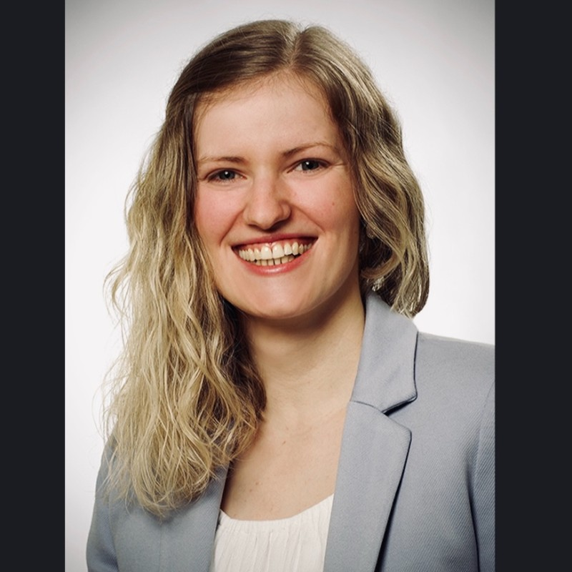
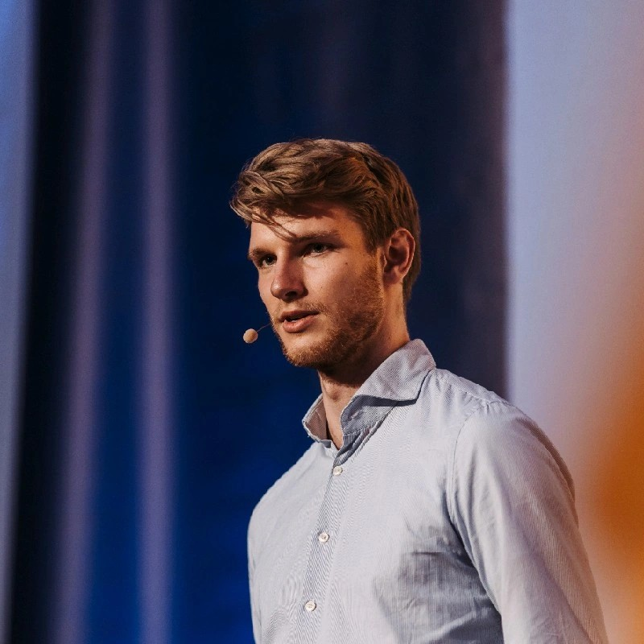













TEAM
>11
years of full-stack coding experience
>1
year of VC experience
>11
years of startup experience
COSIMA FALLER
Design & med. Doc.
FLORIAN
FALLER
ALEXANDER
HALLER
Management
Development
JIJO VALIYAVEETTIL
DEMYAN KURBATOV
are companies we worked at
Development
Development
Notes:
(4) Alexander Haller | LinkedIn
(4) Demyan Kurbatov | LinkedIn
(4) Cosima F. Faller | LinkedIn
(4) Florian Faller | LinkedIn

Slide 14
Analyze

Slide 15
Evaluate

Slide 16
Decide

Slide 17
Invest

Slide 18
DISQOVER
We find, analyze and evaluate startup deals for VCs.
ALEXANDER, COSIMA, DEMYAN, FLORIAN, JIJO

Slide 19
Appendix
BACKUP
Notes:
(4) Alexander Haller | LinkedIn
(4) Demyan Kurbatov | LinkedIn
(4) Cosima F. Faller | LinkedIn
(4) Florian Faller | LinkedIn

Slide 20
Tech
Multi-agent-architecture
Takes PitchDeck PDF
Orchestrator Agent
Gives startup score
Extract Data from PitchDeck
Fill the gaps in the startup information
Extractors Agents
Processor Agents
Agent Layer
PDF-Extractor Agent
Web-Extractor
Agent
News Agent
LinkedIn Agent
Financial Agent
Tools
Parsers
Core Layer
PDF-Extraction Tool
Web-Search
NewsAPI
Parser
LinkedIn
Parser
SEC EDGAR
Parser

Slide 21
Solution
LIVE DEMO
LINK

Slide 22
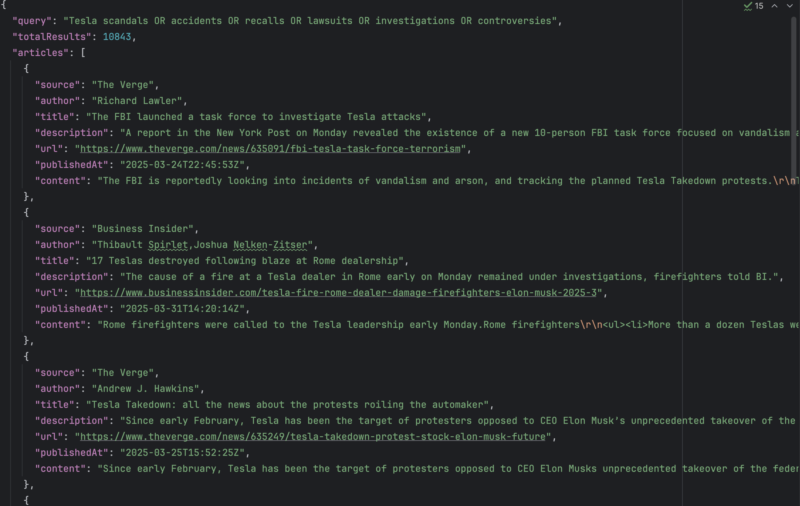
Tech
News agent – raw news

Slide 23
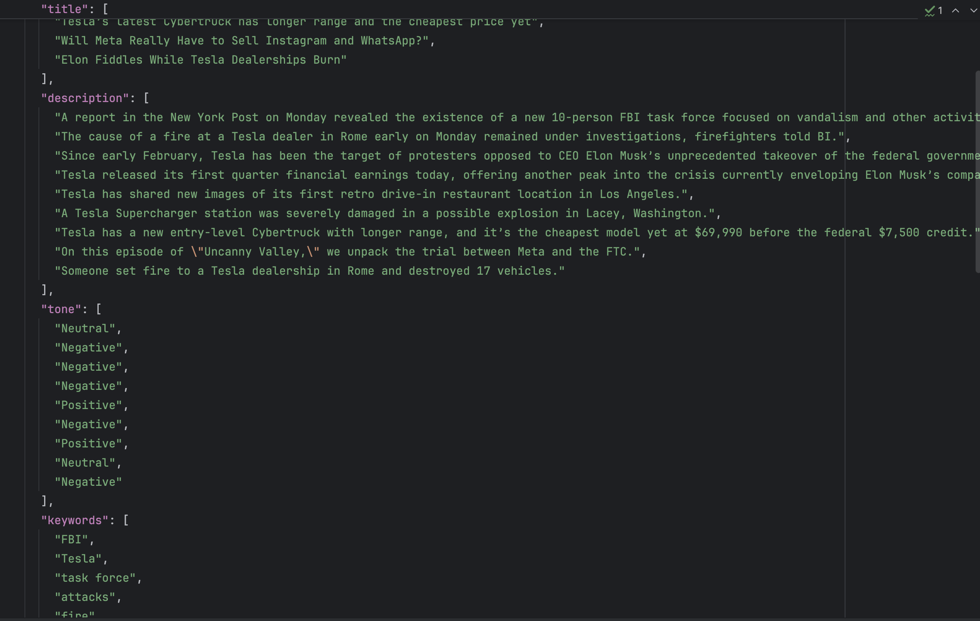
Tech
News agent – pre-processed news

Slide 24
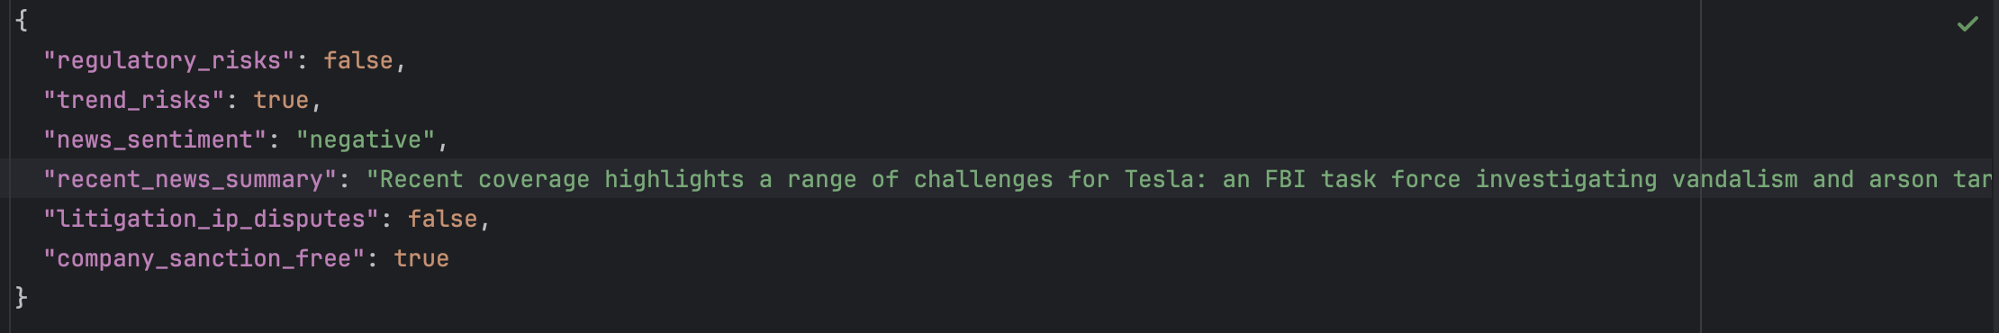
Tech
News agent – final output

